Slide 1
Molecular Dynamics: Spatial Correlation Functions
Yuan Ping
Credits to Dane Morgan

Slide 2
Outline
Pair distribution function
Examples for crystal, amorphous, liquid, gas

Slide 3
Spatial Correlation Functions: Pair Distribution Function
Spatial correlation functions tell you how atoms are positioned relative to each other in space
The most common is g(r), which is the pair (or radial) distribution function. It is the probability of finding particles a distance r apart in the real system relative to the probability for randomly distributed particles.

Slide 4
Spatial Correlation Functions: Pair Distribution Function
To calculate g(r)
Δr
r

Slide 5
Spatial Correlation Functions: Species Dependent Pair Distribution Function
Same as pair distribution function but count only pairs of certain species, I and J.
To calculate g_{IJ}(r)
Question – can you guess qualitatively what g(r) looks like for crystalline solid, liquid, gas, amorphous solid?

Slide 6
Basic Types of Pair Correlation Functions
Crystalline solid: Sharp peaks (neighbor shells) spread out by chemical disorder, vibrations.
Liquid: Wide diffuse neighbor shells (our to 2-3 neighbor shells, then flat)
Amorphous solid: Similar to liquid
Gas: Exluded repulsion region with single neighbor shell with long tail.

Slide 7
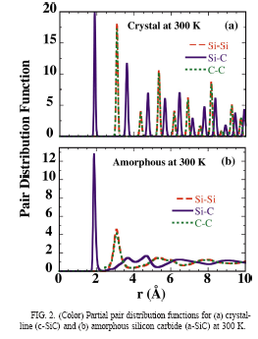
Pair Distribution Function for Crystalline SiC from MD
Rino, et al., PRB ‘04
1NN Shell
2NN Shell
3NN Shell
Strong repulsion

Slide 8
Pair Distribution Function for Amorphous SiC from MD
Rino, et al., PRB ‘04
1NN Shell
2NN Shell
3NN Shell
Strong repulsion

Slide 9
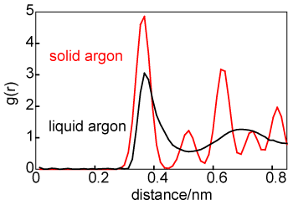
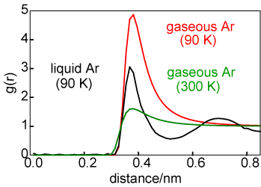
Pair Distribution Ar: Gas, Liquid, Solid
http://rkt.chem.ox.ac.uk/lectures/liqsolns/liquids.html
Gas has no neighbor shells
Liquid has smooth neighbor shells
Solids have sharper neighbor shells

Slide 10
Summary
Trajectories can be analyzed directly to track mechanical deformation mechanisms.
The pair distribution function given spatial structure and is defined as
The pair distribution function can, e.g., be used to tell when something has melted, can be compared to experimental measurements to assess structural similarity (e.g., in amorphous materials). Note that the pair distribution function can be measured experimentally by scattering (xray, neutron, electron) for direct comparisons.

Slide 11
Backup

Slide 12
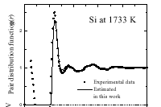
Pair Distribution Function for Liquid Si
Ref ?
1NN Shell
2NN Shell
3NN Shell
Strong repulsion

Slide 13
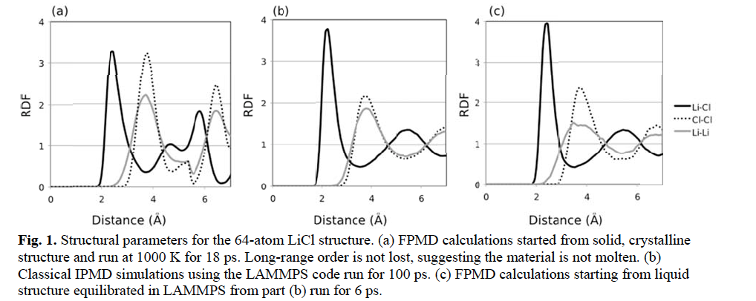
Pair Distribution Functions for Li-Cl Salt
Bengtson, et al JNM ‘14
Used to determine if MD simulation is liquid or not

